Slide 1
Shenzhen
We applied SelfSim to Shenzhen, simulated how its urban system would evolve over time from 2021 to 2030. The scaling factor is 1:1000 (i.e., each agent in the simulation represents 1000 people in reality). The model is calibrated by comparing the observed and simulated home sale prices and population distribution between 2021 and 2023. The mean absolute percentage errors(MAPE) were 9.2% and 4.7%, respectively.

Slide 2
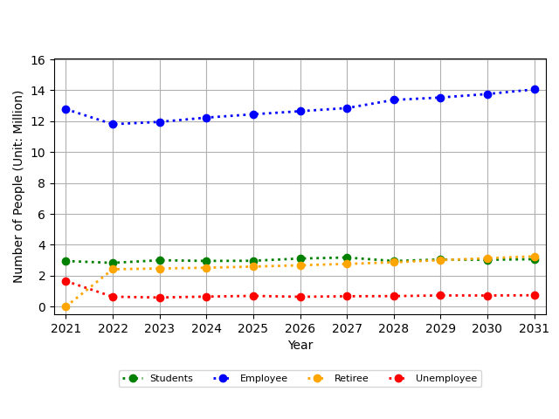
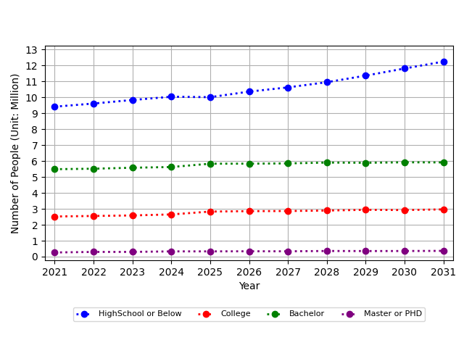
Part 1: Key results
(a)Education Population Change
(b)Work Population Change

Slide 3
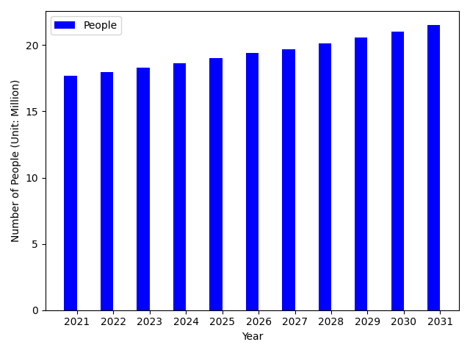
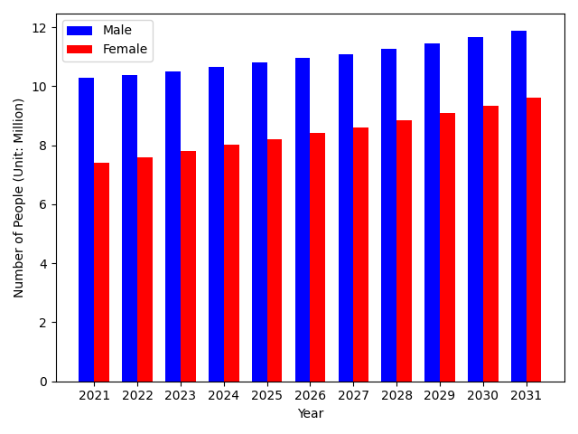
(c)People Population Change
(d)Gender Population Change

Slide 4
Part 1: Spatial Distribution Results
(a)Average house selling price of residential buildings

Slide 5
(b)Average house rent of residential buildings

Slide 6
(c)Number of people

